Slide 1
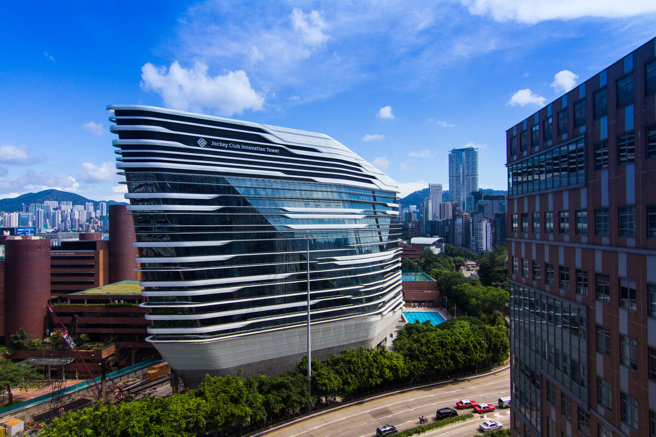
Introduction of
Technical Skills & Project Experiences
ZHOU Xiangru (Johnson)
- from PolyU

Slide 2
OUTLINE
1. Technical Skills
2. R&D Background
3. Representative Projects
4. Future Plans

Slide 3
01.
Technical Skills

Slide 4
Personal Introduction
Technical Skills
Programming Languages: C, C++, Python, Java, JS, HTML, CSS, PHP
Platforms: (Local) Windows, Ubuntu; (Remote) Linux, HPC, Aliyun ECS etc.
Development Tools & Libraries: OpenCV, PyTorch, QT, Visual Studio, gdb/pdb, Git, Docker/Apptainer, Anaconda, Halcon, DeePMD, GPUMD, OpenMM, LAMMPS, OVITO
Other Skills: Keil (STM32), Altium Designer (PCB), Rhino (3D printing), Dreamweaver (Website)

Slide 5
02.
R&D Background

Slide 6
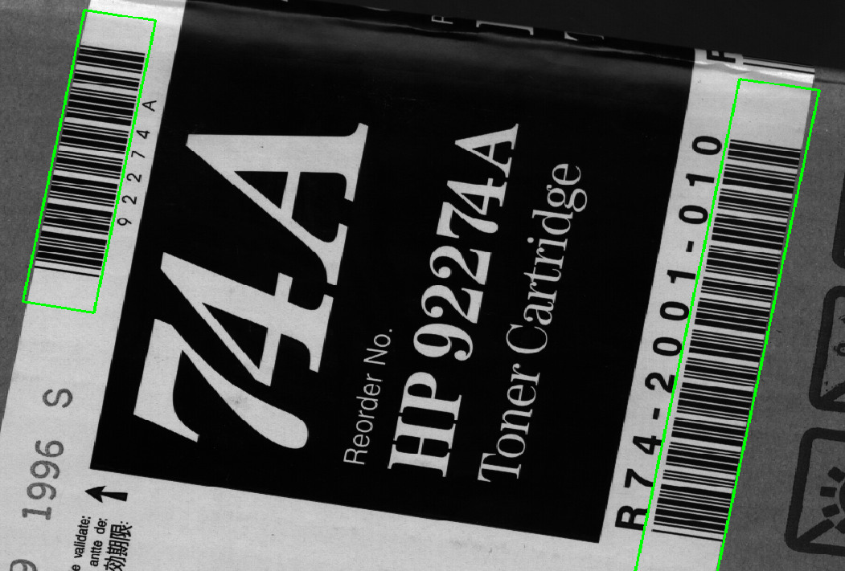
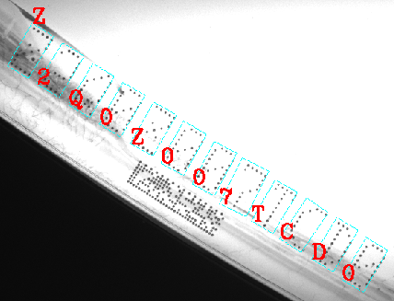
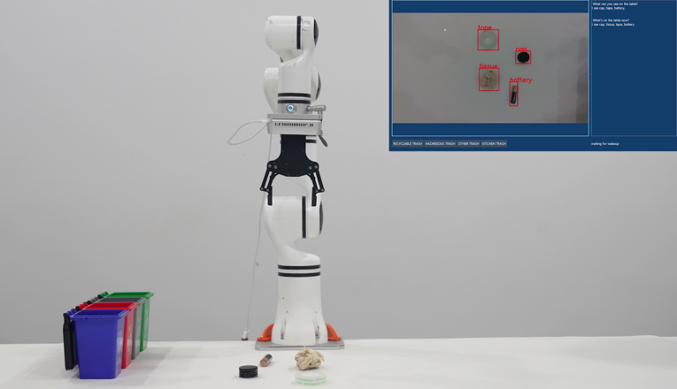
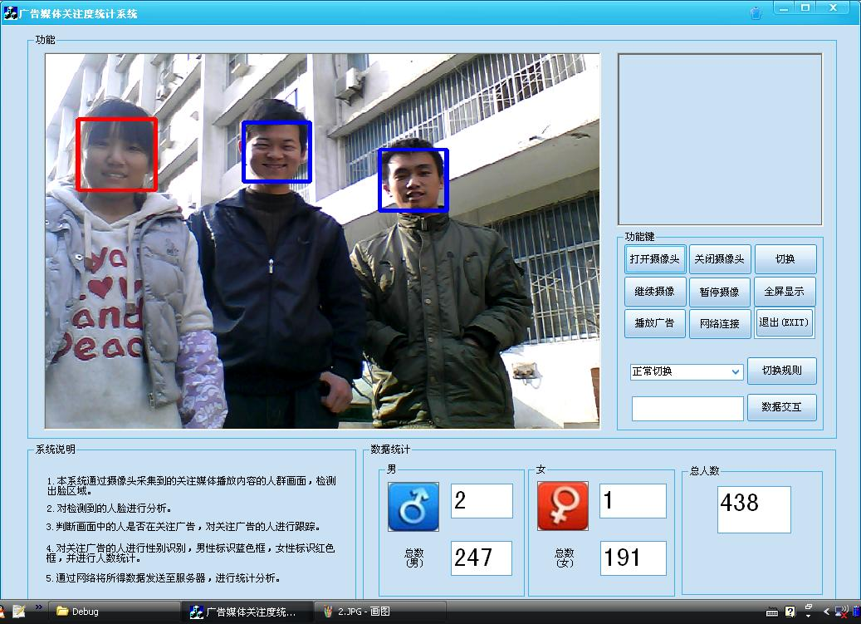
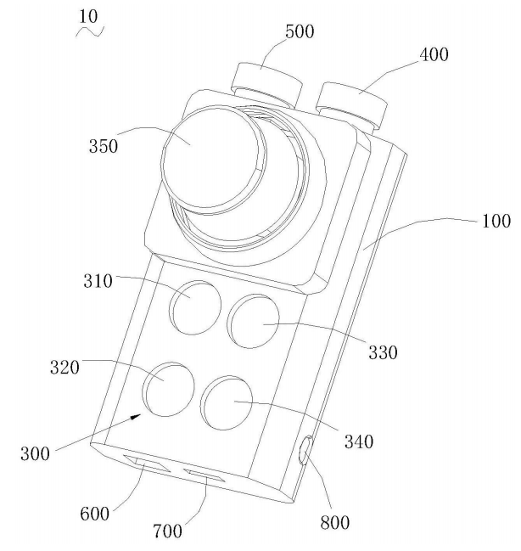
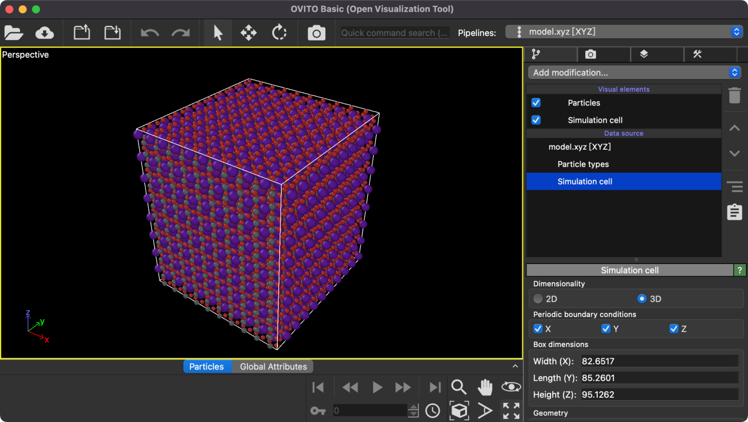
Personal Introduction
R&D Background
Algorithm Software Engineer (2014~2016)
Software Development Engineer (2020~2024)
SOTA
6 Patents
SOTA
Image Processing
AI+
Bachelors (2009~2013)
Fullstack Technician (2016~2020)
Masters (2024~2025)
2 Patents
2 Patents
SOTA

Slide 7
03.
Representative Projects

Slide 8
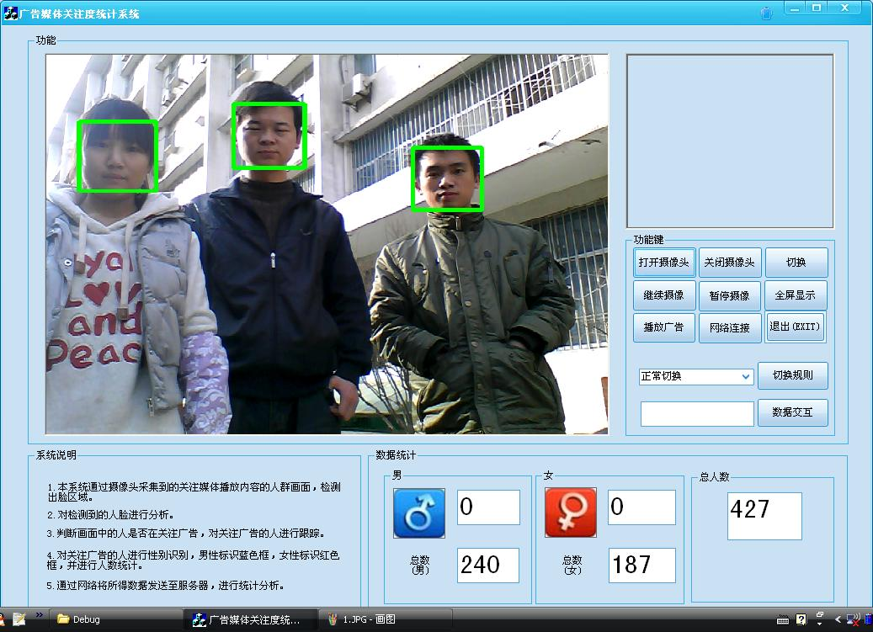

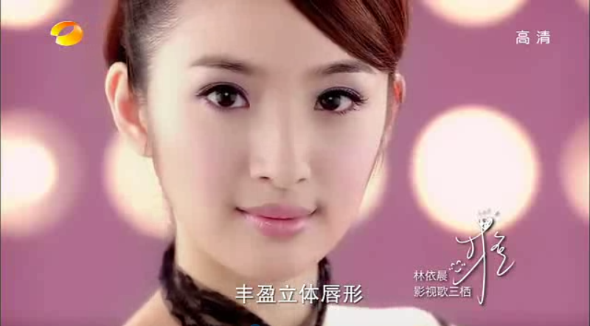
Personal Introduction
Face Detection & Traction & Gender Detection
Advertising Attention Statistics

Slide 9
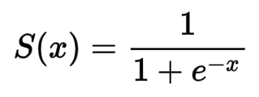
Personal Introduction
Classification (Gender Detection)
// Convert Image to gray if necessary
// A = flatten 2D-face image
// [1, 4096] x [4096, 30](param0[4096][30]) = [1, 30]
// find max & min
// normalization(to [0, 1.000])
// [1, 30](Sigmoid) x [30, 10](param1[30][10]) = [1, 10]
// [1, 10] x [10, 1](param2[10]) = scalar ( thresh = 0.5 )

Slide 10
Personal Introduction
Barcode Detection (Blob Analysis)
Canny Edge Detection:
(1) Edge Detection
(2) Filtering Target
1) Too slow
2) Too many parameters

Slide 11
Personal Introduction
Barcode Detection (Line Scanning)
(1) Coarse Location
(2) Line Segment Clustering

Slide 12
Personal Introduction
Barcode Detection (Refining)
(3) Extract and connect
line segments
(4) Obtain the area
formed by several
parallel line segments
(5) Search along the
direction of the barcode

Slide 13
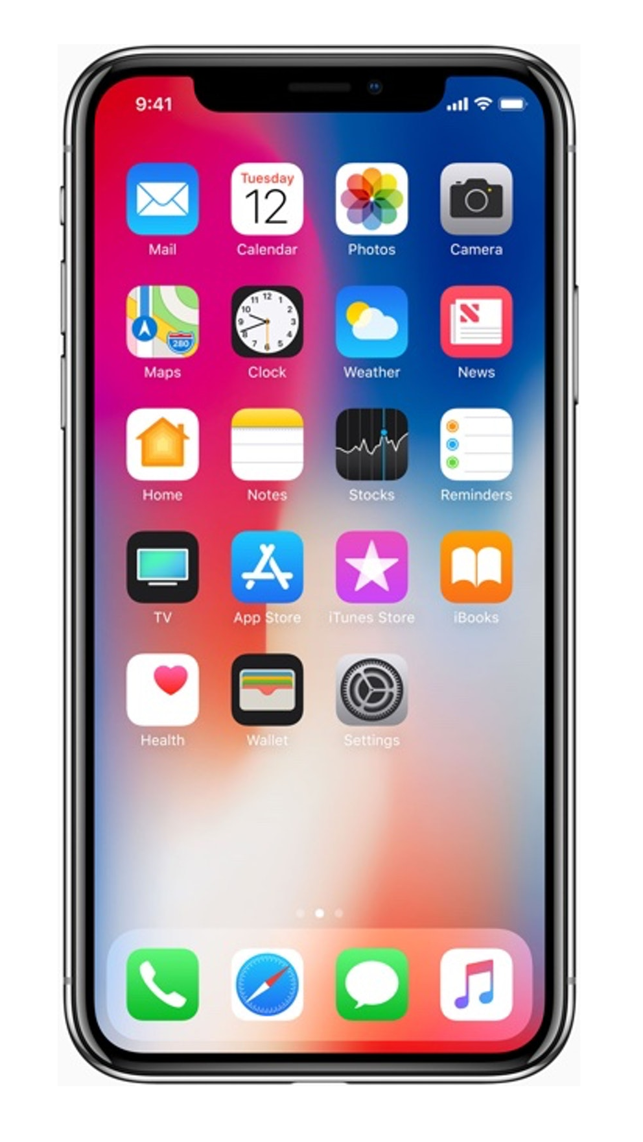
Personal Introduction
Smart Phone Controller (with image processing)
Basic Command
Volumae +/- Next/Prev. Pause/Resume
Visual Command
Core
Screenshot (with Image Processing)
Route planning
Key command
Keyboard action
Keyboard HID key
Mouse move command
Mouse action (with image supervised)
Mouse HID move action
Speech to Text
Intention Analyzation
Voice Command

Slide 14
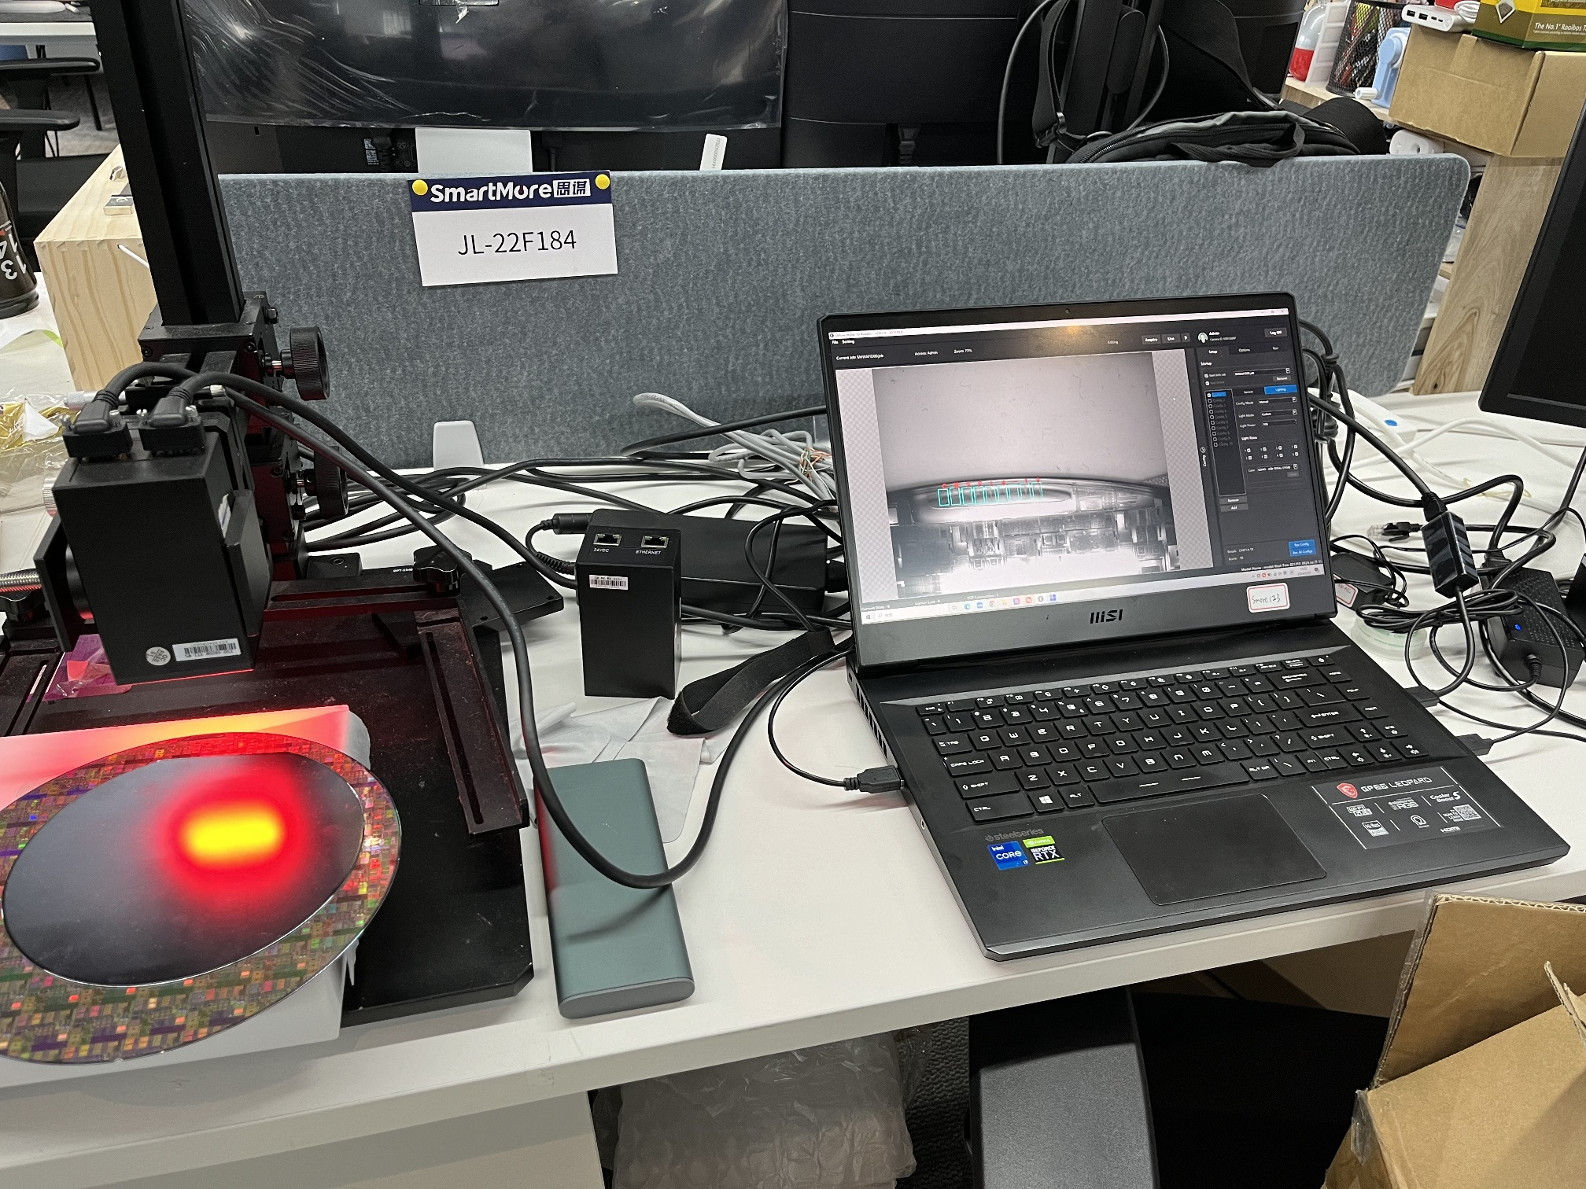
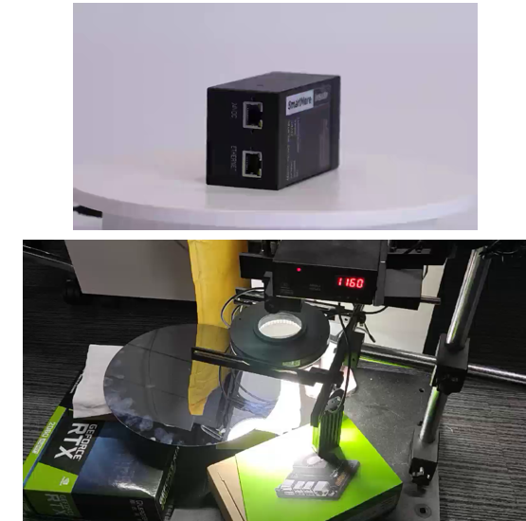
Personal Introduction
Wafer ID Reader

Slide 15
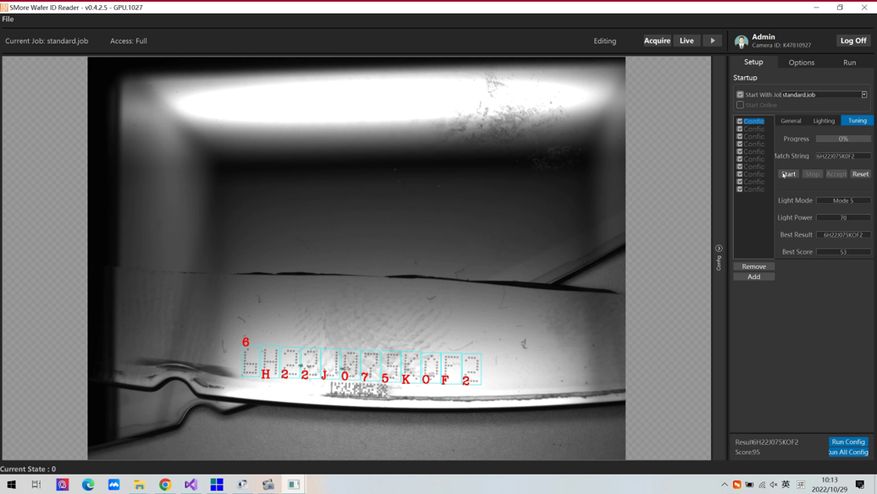
Personal Introduction
Wafer ID Reader

Slide 16
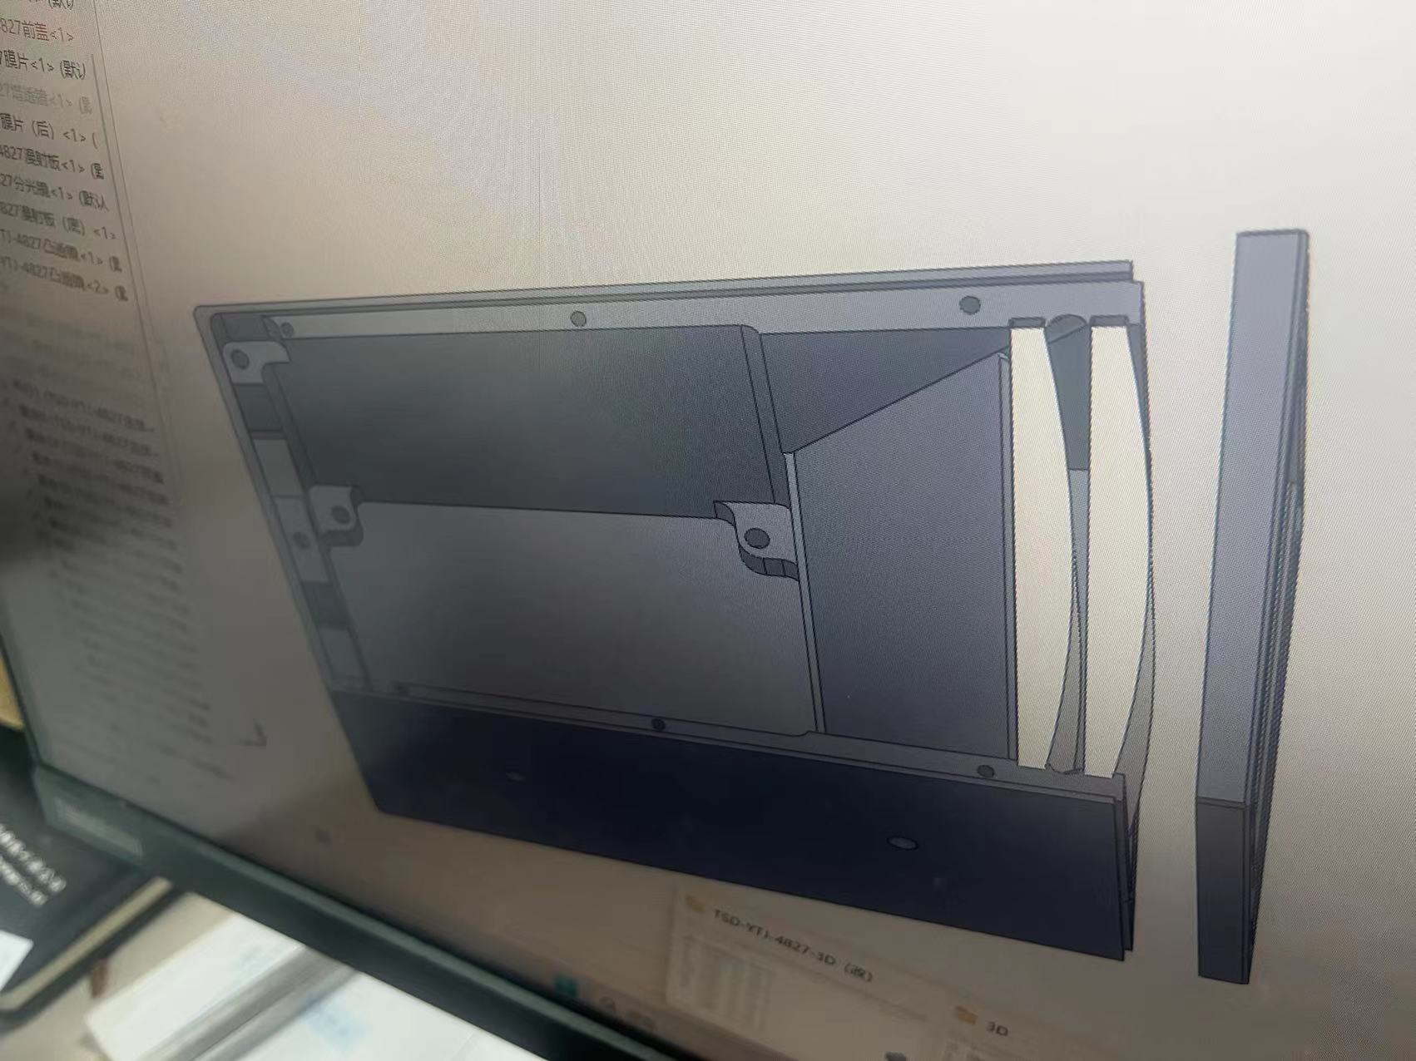
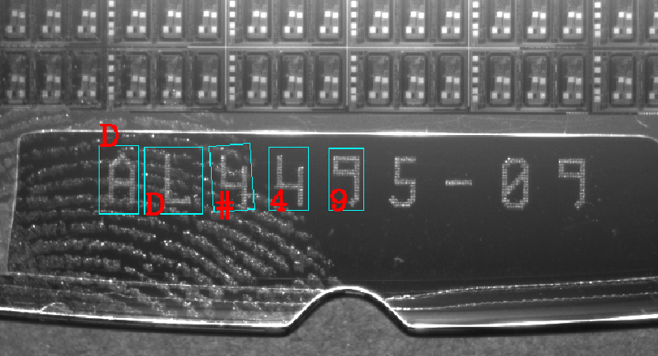
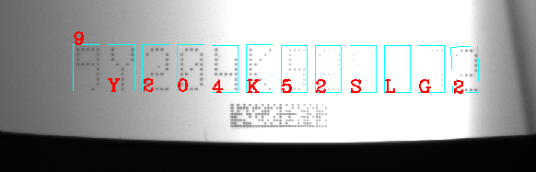
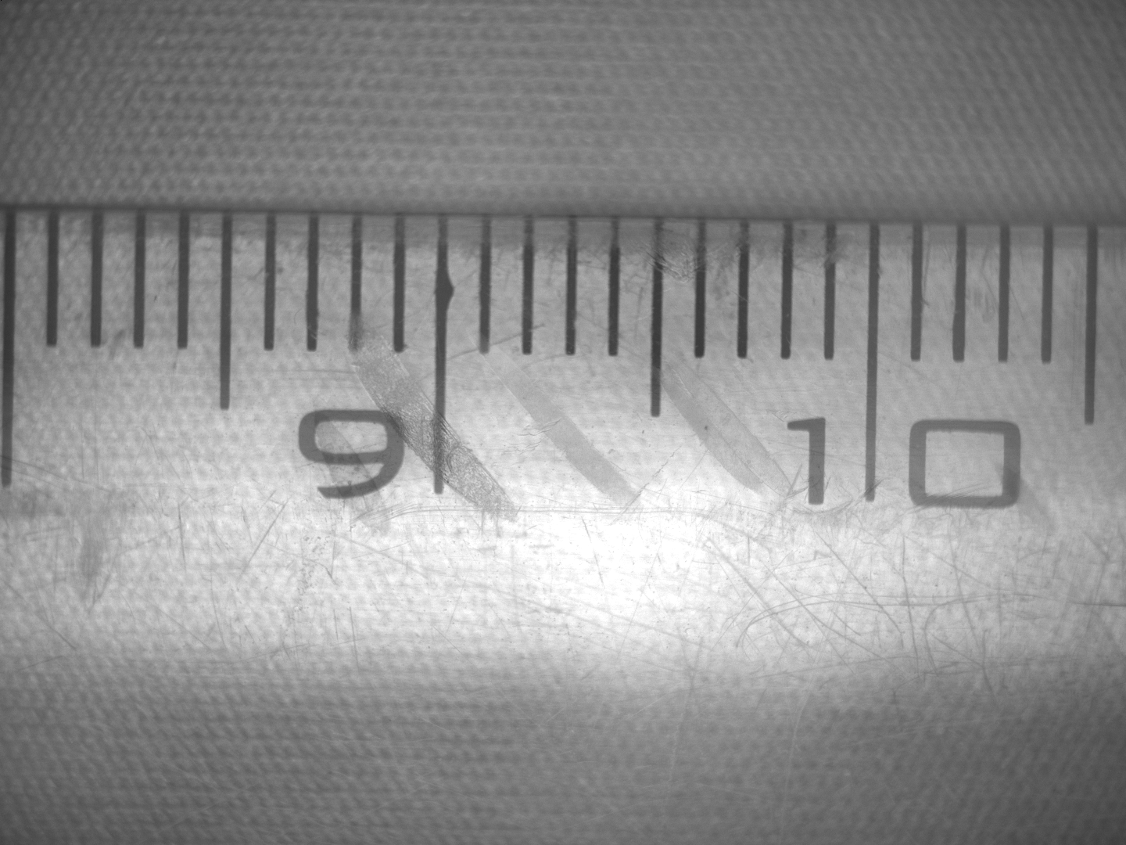
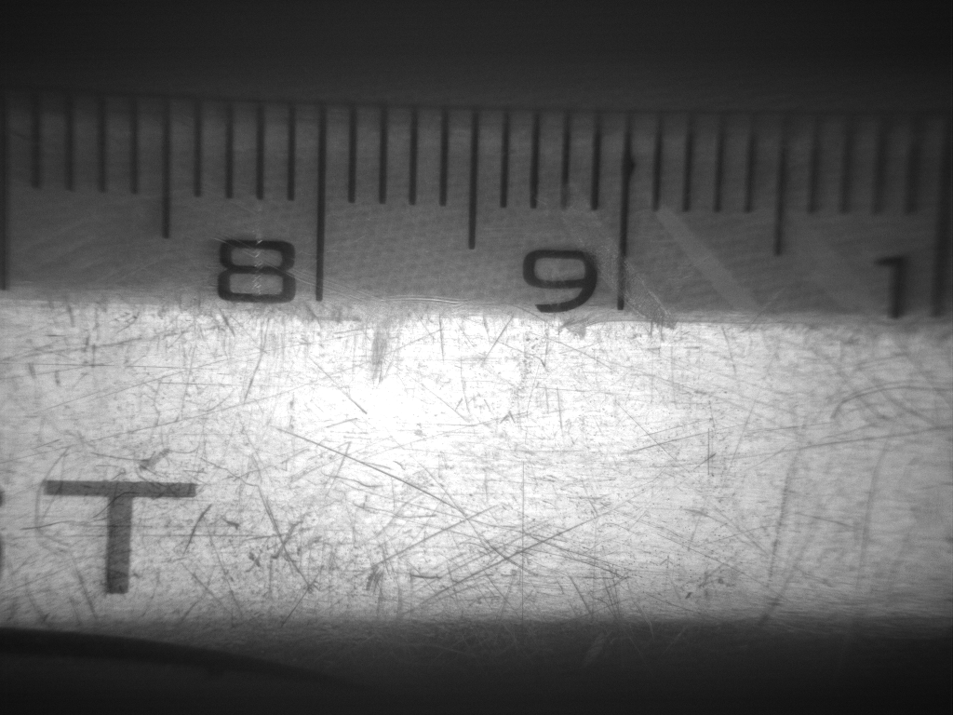
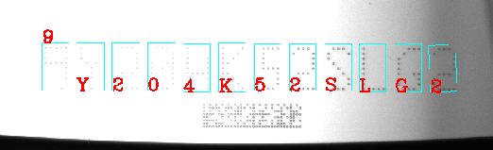
Personal Introduction
OCR
Hardware
Software & Algorithm

Slide 17
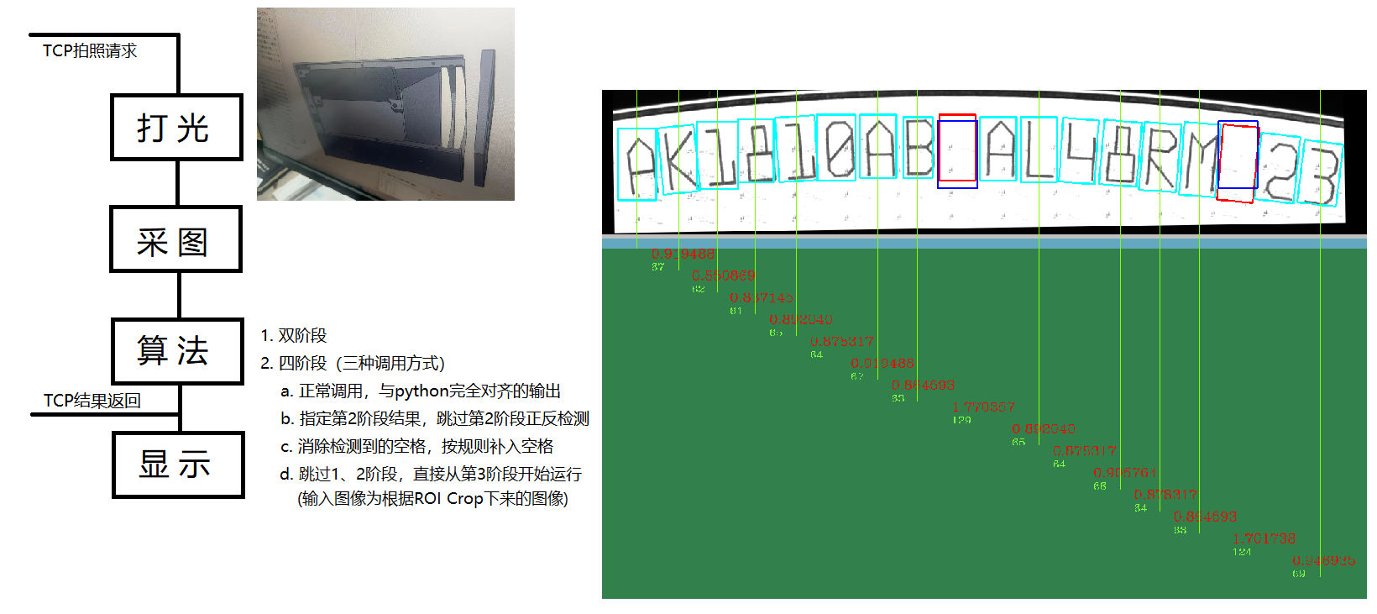
Personal Introduction
Wafer ID Reader Workflow

Slide 18
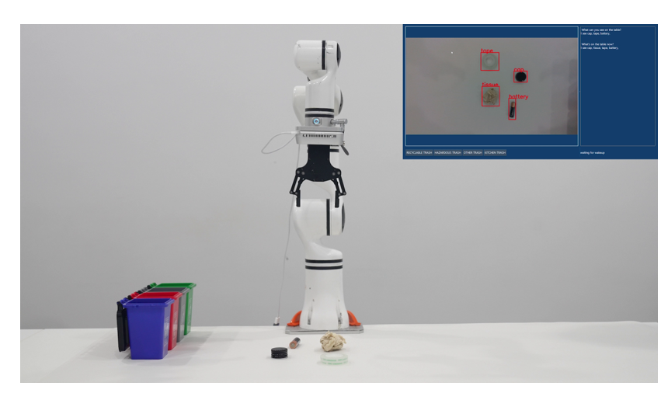
Personal Introduction
Smart Robot Arm

Slide 19
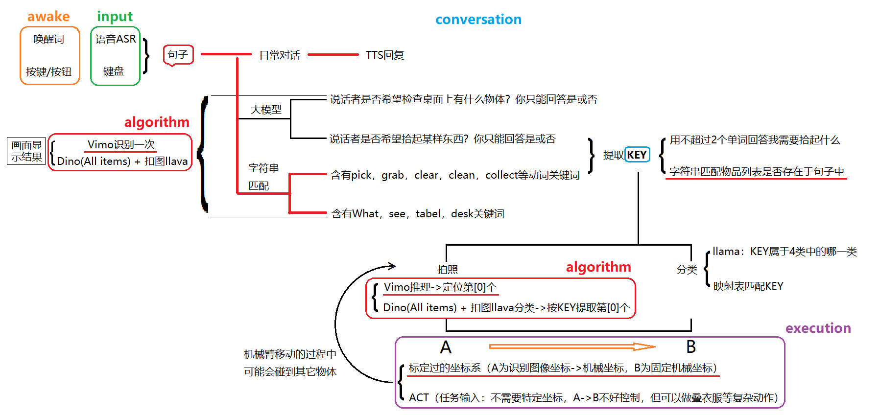
Personal Introduction
Smart Robot Arm Workflow

Slide 20
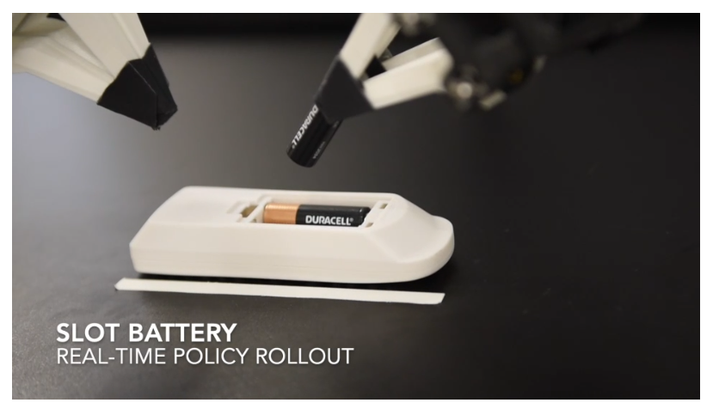
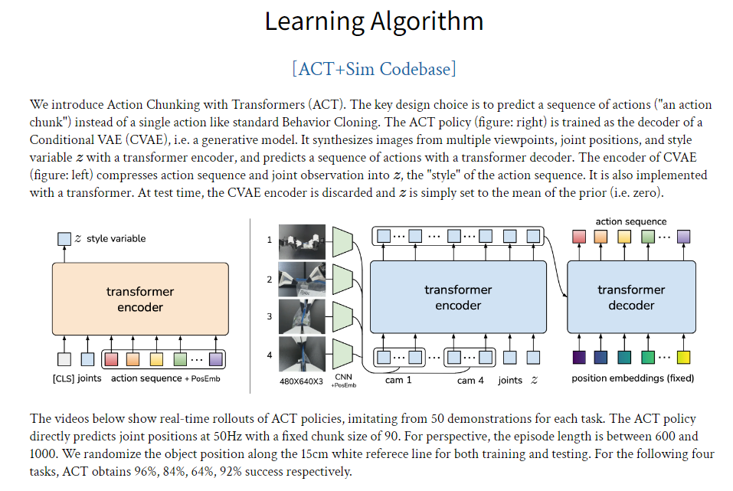
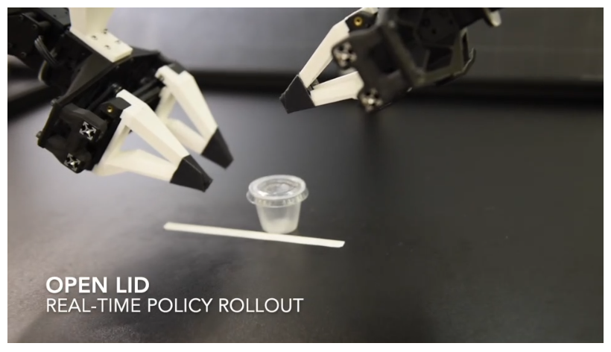
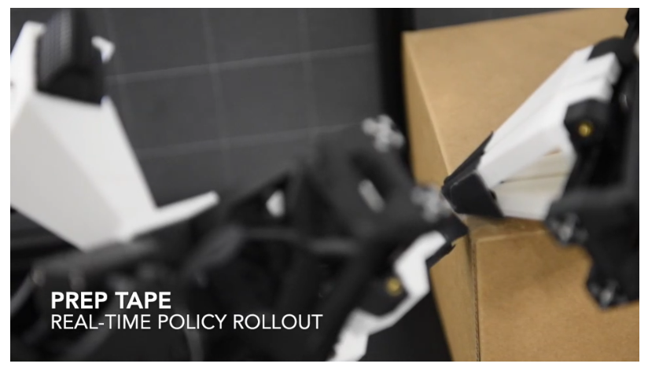
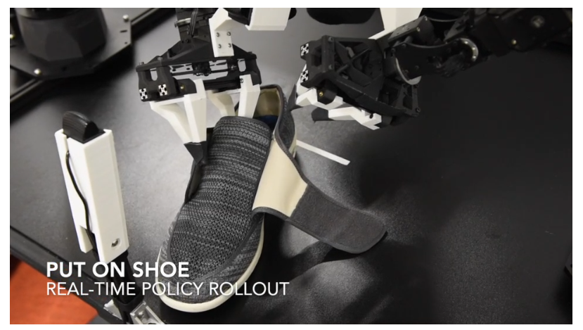
Personal Introduction
ACT (Action Chunking with Transformers)

Slide 21
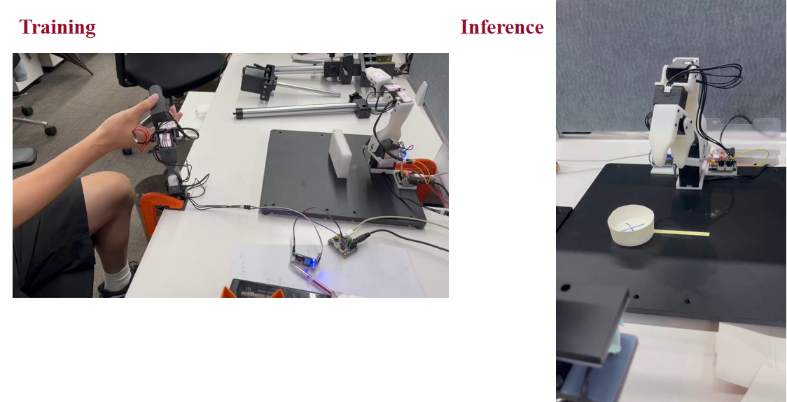
Personal Introduction
Robot Arm Trajectories
Training
Inference

Slide 22
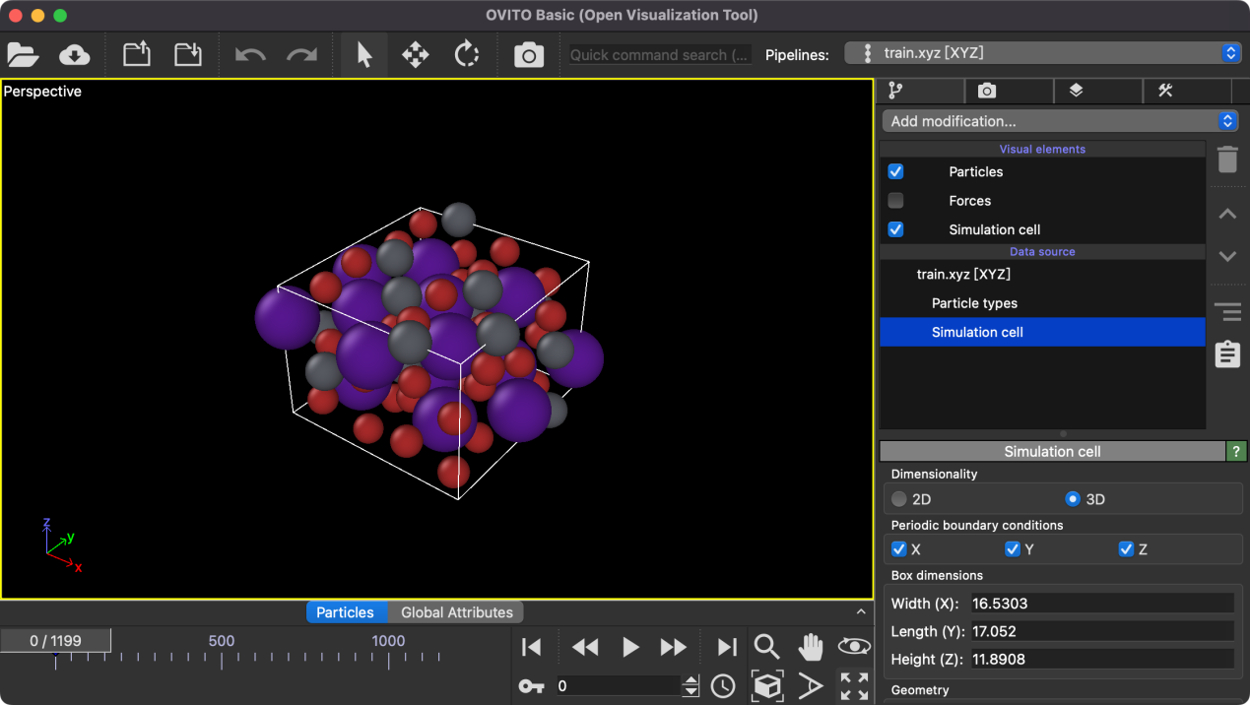
Personal Introduction
Molecules Dynamics Objection

Slide 23
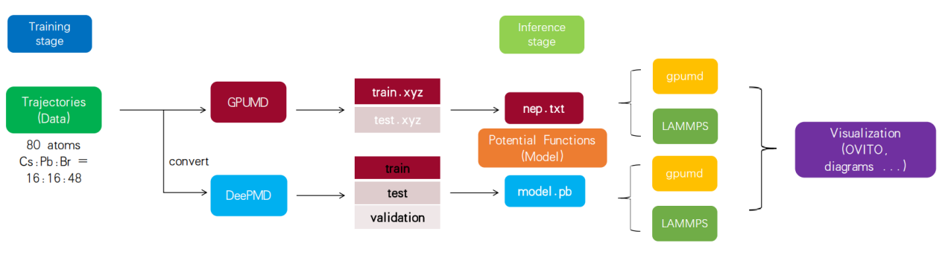
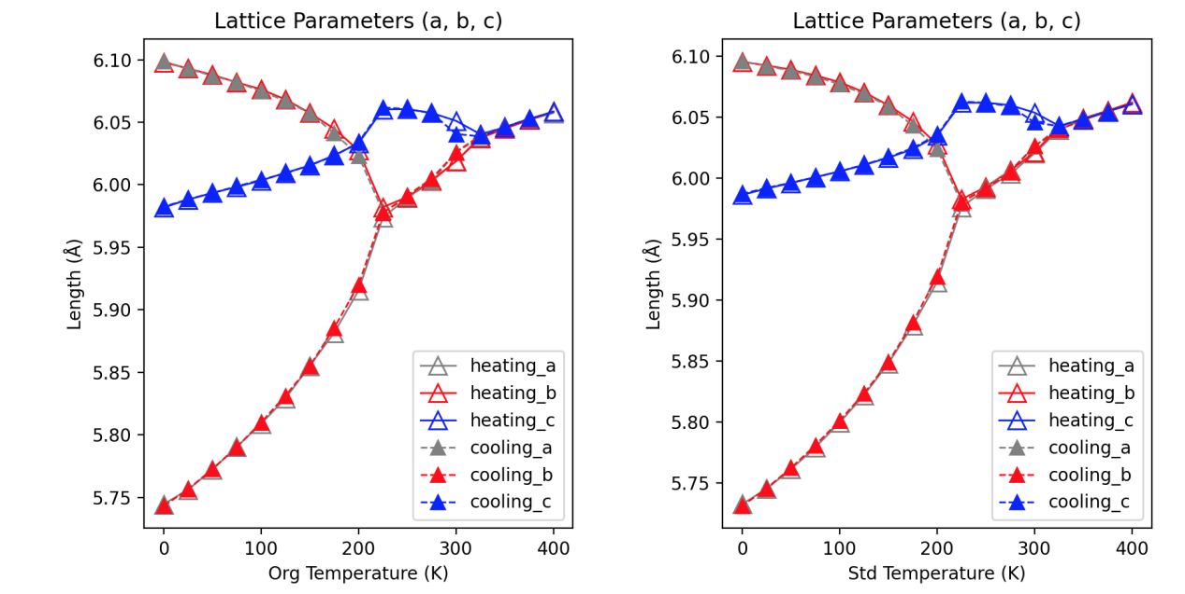
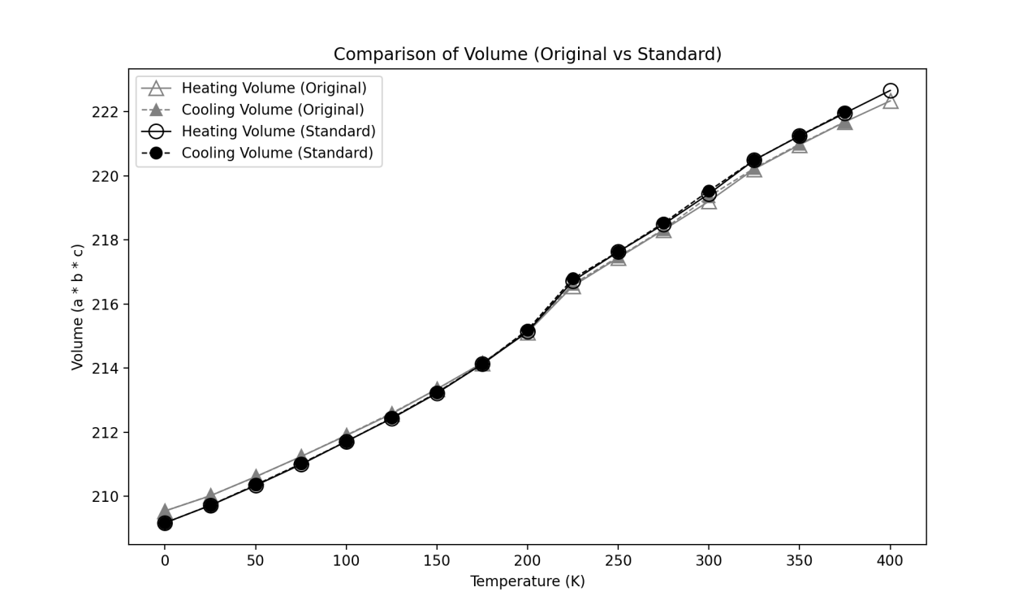
Personal Introduction
Molecules Dynamics with Different Platforms
[1] Y. Shi, Y. Chen, H. Dong, H. Wang, and P. Qian, “Investigation of phase transition, mechanical behavior and lattice thermal conductivity of halogen perovskites using machine learning interatomic potentials,” Physical Chemistry Chemical Physics, vol. 25, no. 44, pp. 30644–30655, 2023.

Slide 24

Personal Introduction
Combination of Algorithm Enginneering & Clinic in Bones
Finite Element Analysis
Algorithm
Clinic
Medical Image Analysis
Abaqus
X-Ray
Ansys
CT
MRI
Molecular Dynamics
Implantable Sensing
Temperature
Humidity
Engineering
Pressure
Biomedical Image Processing
Classical
Image Processing Integration
Artificial Intelligence
Image Auto Collection & Sorting
User Friendly Interface Software Development
AI Acceleration
AI System Deployment & Adjustment

Slide 25
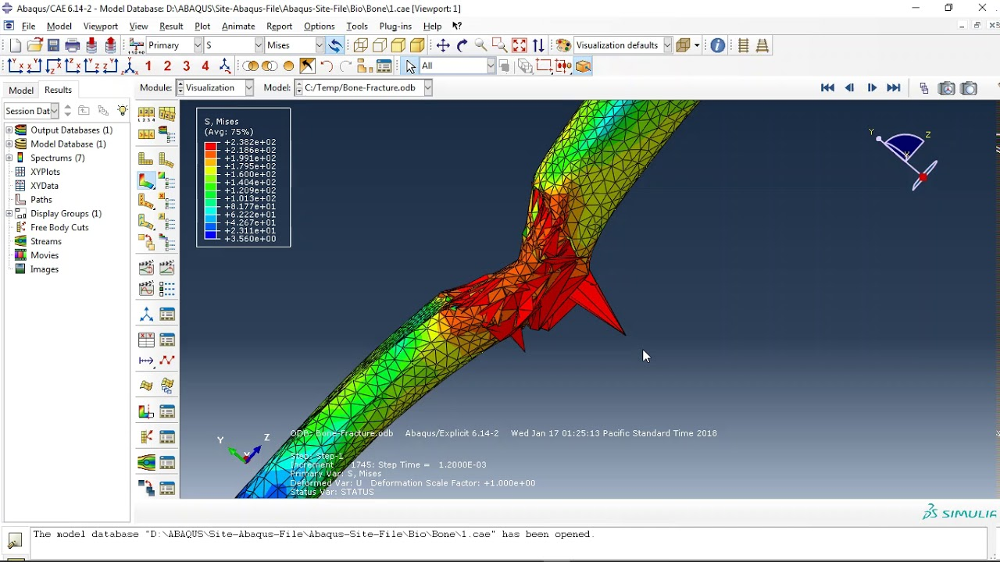
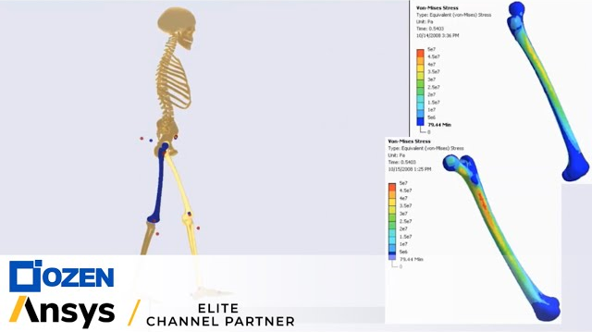
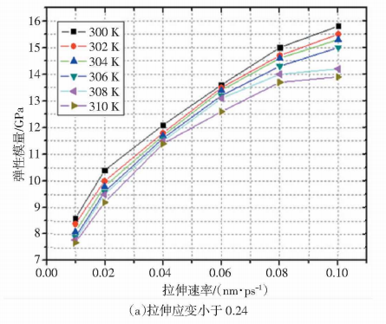
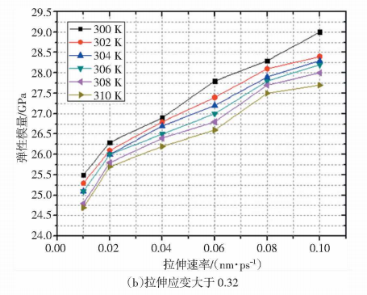




Personal Introduction
Combination of Algorithm Enginneering & Clinic in Bones
Algorithm
Finite Element Analysis
Abaqus
Ansys
Complex material simulation
Multi-physics coupling (fluid/thermal/electromagnetic)
Nonlinear mechanics
Fast simulation
Molecular Dynamics
Biomedical Image Processing
Classical
Artificial Intelligence
Circularity
Rectangularity
Area/Perimeter
Skeleton
Segmentation
Detection
Classification

Slide 26
Personal Introduction
Combination of Algorithm Enginneering & Clinic in Bones
Engineering
Image Processing Integration
Integrate image processing with camera image capture, communication, inference, result display & feedback, and UI interaction into an automated software workflow, eliminating the need for separate operation of each link on different devices.
Image Auto Collection & Sorting
Use classification models or preset rules to automatically name, classify and store collected images and data, serving subsequent data processing, model training & validation, and data augmentation.
User Friendly Interface Software Development
Develop visual interfaces via QT or similar tools, encapsulate complex algorithms and processes, and lower the threshold for medical staff and technicians to use AI and algorithms.
AI System Deployment & Adjustment
Deploy adaptive versions based on computing power and platforms of different clinical scenarios to ensure algorithm coverage across various application scenarios.
AI Acceleration
Depending on project requirements, accelerate model training, inference validation in the lab, and speed up offline clinical inference using methods like CUDA, TBB multi-threading, or AVX instruction set optimization.

Slide 27
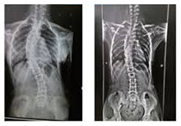
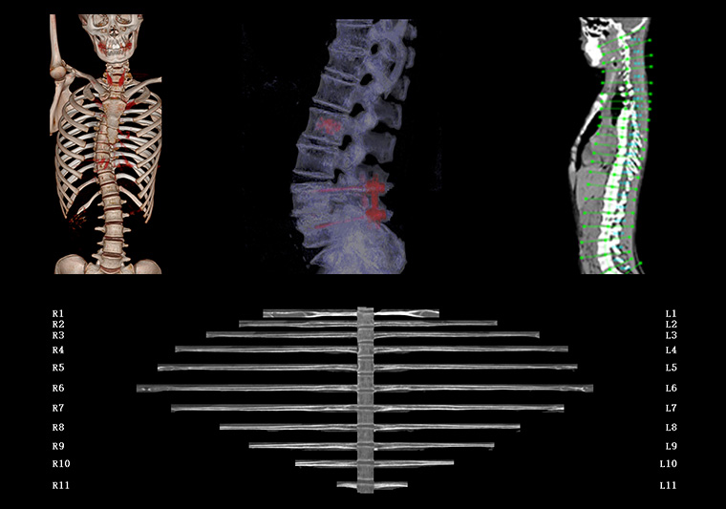
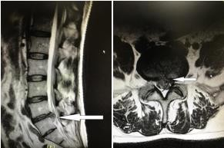
Personal Introduction
Combination of Algorithm Enginneering & Clinic in Bones
Clinic
Medical Image Analysis
X-Ray
CT
MRI
As mentioned above, an integrated system that combines image acquisition, algorithmic inference, and result display & transmission can be built for both online and offline clinical scenarios. At the same time, data is automatically collected, classified and stored to support subsequent offline model training and data augmentation.
Implantable Sensing
Dynamic monitoring of implant-related parameters (Temperature, Humidity, Pressure) and human body parameters (Tissue Strain, Joint Angle, Tendon Tension, Bone Load, pH Value, Blood Oxygen Saturation, Blood Glucose Concentration, Body Fluid Ion Concentration) not only assists in assessing tissue metabolic status and implant degradation environments but also enables feedback of monitored data to MD or FEA as input parameters or calibration references. This helps enhance the realism and accuracy of simulations, optimize implant design, predict postoperative complications (e.g., loosening caused by stress concentration), and provide data support for customized treatment plans.

Slide 28
Personal Introduction
Combination of Algorithm Enginneering & Clinic in Bones
Finite Element Analysis
Algorithm
Clinic
Medical Image Analysis
Abaqus
Feedback
X-Ray
Ansys
CT
MRI
Molecular Dynamics
Implantable Sensing
Temperature
Humidity
Integrated
Engineering
Deployed
Pressure
Biomedical Image Processing
Classical
Image Processing Integration
Artificial Intelligence
Image Auto Collection & Sorting
User Friendly Interface Software Development
AI Acceleration
AI System Deployment & Adjustment

Slide 29
THANK
YOU

